Slide 1
"Mama always said life was like a box of chocolates. You never know what you're gonna get."
exams
But every exam you get is going to teach you something along the way and make you the person you are today. That's the exciting part - it's an adventure in itself.
Notes:
1994 Forrest Gump

Slide 2
COMP 3500 Introduction to Operating Systems Midterm Exam 1 Review
Dr. Xiao Qin
Auburn University http://www.eng.auburn.edu/~xqin
xqin@auburn.edu
Notes:
50 Minutes slides 1-13
To present the concept of process synchronization.
To introduce the critical-section problem, whose solutions can be used to ensure the consistency of shared data
To present both software and hardware solutions of the critical-section problem
To examine several classical process-synchronization problems
To explore several tools that are used to solve process synchronization problems

Slide 3
Types of Questions
Part 1: 20 Points (20%)
T/F. 10 Points on Canvas
Multiple Choice (one choice per question). 10 Points
Part 2: 100 Points (80%)
Short answer questions. 15 Points
Mutual Exclusion. 20 Points
Process Management. 15 Points
OS/161. 20 Points
Synchronization. 30 Points
Notes:
Goals:
Run program
Users: easy use computer systems
Applications: hardware efficiency

Slide 4
What are operating system goals?
A program that acts as an intermediary between a user of a computer and the computer hardware
Operating system goals:
Execute user programs and make solving user problems easier
Make the computer system convenient to use
Use the computer hardware in an efficient manner
Notes:
Goals:
Run program
Users: easy use computer systems
Applications: hardware efficiency

Slide 5
What do users and mainframes want from operating systems, respectively?
Convenience
Resource utilization
Ease of use
Fast throughput
Short response time
Low cooling cost
Long battery life
Notes:
User vs. System views
Users want convenience, ease of use and good performance
Don’t care about resource utilization
But shared computer such as mainframe or minicomputer must keep all users happy
Users of dedicate systems such as workstations have dedicated resources but frequently use shared resources from servers
Handheld computers are resource poor, optimized for usability and battery life
Some computers have little or no user interface, such as embedded computers in devices and automobiles
Users:
Convenience
Ease of use
Short response time
Long battery life
Mainframes:
Resource utilization
Fast throughput
Cooling cost

Slide 6
System View: Operating System Definition
OS is a resource allocator
Manages all resources
Decides between conflicting requests for efficient and fair resource use
OS is a control program
Controls execution of programs to prevent errors and improper use of the computer

Slide 7
Key Interfaces
Application programming interface (API)
Application binary interface (ABI)
Instruction set architecture (ISA) –COMP4300 (e.g., add $d,$s,$t)
Notes:
ABIs differ from application programming interfaces (APIs), which similarly define interfaces between program components, but at the source code level.
Figure 2.1 also indicates three key interfaces in a typical computer system:
• Instruction set architecture (ISA) : The ISA defines the repertoire of machine
language instructions that a computer can follow. This interface is the boundary
between hardware and software. Note that both application programs
and utilities may access the ISA directly. For these programs, a subset of the
instruction repertoire is available (user ISA). The OS has access to additional
machine language instructions that deal with managing system resources
(system ISA).
• Application binary interface (ABI) : The ABI defines a standard for binary
Reference: https://en.wikipedia.org/wiki/Application_binary_interface
portability across programs. The ABI defines the system call interface to
the operating system and the hardware resources and services available in a
system through the user ISA.
In computer software, an application binary interface (ABI) is the interface between two program modules, one of which is often a library oroperating system, at the level of machine code.
• Application programming interface (API) : The API gives a program access
to the hardware resources and services available in a system through the user
ISA supplemented with high-level language (HLL) library calls. Any system
calls are usually performed through libraries. Using an API enables application
software to be ported easily, through recompilation, to other systems that
support the same API.
systemd is a suite of system management daemons, libraries, and utilities designed as a central management and configuration platform for the Linuxcomputer operating system. Described by its authors as a "basic building block" for an operating system,[5] systemd primarily aims to replace the Linux initsystem (the first process executed in user space during the Linux startup process) inherited from UNIX System V and Berkeley Software Distribution(BSD). The name systemd adheres to the Unix convention of making daemons easier to distinguish by having the letter d as the last letter of the filename.

Slide 8
Serial Processing
Earliest Computers:
Problems:
No operating system
programmers interacted directly with the computer hardware
Computers ran from a console with display lights, toggle switches, some form of input device, and a printer
Users have access to the computer in “series”
Scheduling:
most installations used a hardcopy sign-up sheet to reserve computer time
time allocations could run short or long, resulting in wasted computer time
Setup time
Long system setup time: A considerable amount of time was spent just on setting up the program to run. How to reduce a long setup time?
Notes:
With the earliest computers, from the late 1940s to the mid-1950s, the programmer
interacted directly with the computer hardware; there was no OS. These computers
were run from a console consisting of display lights, toggle switches, some form of
input device, and a printer. Programs in machine code were loaded via the input
device (e.g., a card reader). If an error halted the program, the error condition was
indicated by the lights. If the program proceeded to a normal completion, the output
appeared on the printer.
These early systems presented two main problems:
• Scheduling : Most installations used a hardcopy sign-up sheet to reserve computer
time. Typically, a user could sign up for a block of time in multiples of a
half hour or so. A user might sign up for an hour and finish in 45 minutes; this
would result in wasted computer processing time. On the other hand, the user
might run into problems, not finish in the allotted time, and be forced to stop
before resolving the problem.
• Setup time: A single program, called a job , could involve loading the compiler
plus the high-level language program (source program) into memory,
saving the compiled program (object program) and then loading and linking
together the object program and common functions. Each of these steps could
involve mounting or dismounting tapes or setting up card decks. If an error
occurred, the hapless user typically had to go back to the beginning of the
setup sequence. Thus, a considerable amount of time was spent just in setting
up the program to run.
This mode of operation could be termed serial processing , reflecting the fact
that users have access to the computer in series. Over time, various system software
tools were developed to attempt to make serial processing more efficient. These
include libraries of common functions, linkers, loaders, debuggers, and I/O driver
routines that were available as common software for all users.

Slide 9
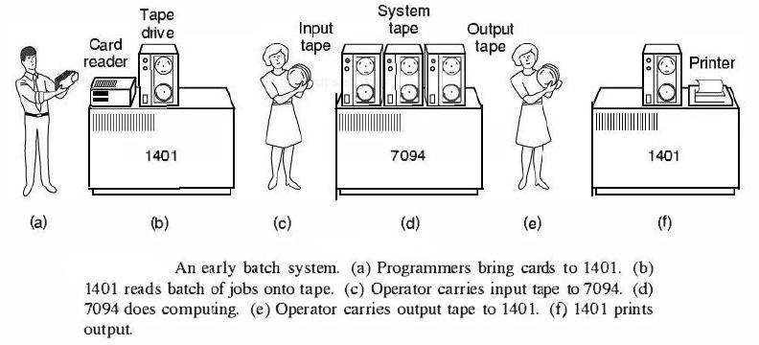
Simple Batch Systems
Early computers were very expensive
important to maximize processor utilization
Monitor
user no longer has direct access to processor
job is submitted to computer operator who batches them together and places them on an input device
program branches back to the monitor when finished
Notes:
Early computers were very expensive, and therefore it was important to maximize
processor utilization. The wasted time due to scheduling and setup time was
unacceptable.
To improve utilization, the concept of a batch OS was developed. It appears
that the first batch OS (and the first OS of any kind) was developed in the mid-1950s
by General Motors for use on an IBM 701 [WEIZ81]. The concept was subsequently
refined and implemented on the IBM 704 by a number of IBM customers. By the
early 1960s, a number of vendors had developed batch operating systems for their
computer systems. IBSYS, the IBM OS for the 7090/7094 computers, is particularly
notable because of its widespread influence on other systems.
The central idea behind the simple batch-processing scheme is the use of a
piece of software known as the monitor . With this type of OS, the user no longer has
direct access to the processor. Instead, the user submits the job on cards or tape to a
computer operator, who batches the jobs together sequentially and places the entire
batch on an input device, for use by the monitor. Each program is constructed to
branch back to the monitor when it completes processing, at which point the monitor
automatically begins loading the next program.

Slide 10
Multiprogramming
There must be enough memory to hold the OS (resident monitor) and one user program
When one job needs to wait for I/O, the processor can switch to the other job, which is likely not waiting for I/O
Notes:
This inefficiency is not necessary. We know that there must be enough
memory to hold the OS (resident monitor) and one user program. Suppose that
there is room for the OS and two user programs. When one job needs to wait for
I/O, the processor can switch to the other job, which is likely not waiting for I/O.
Multiprogramming (Batch system) needed for efficiency
Single user cannot keep CPU and I/O devices busy at all times
Multiprogramming organizes jobs (code and data) so CPU always has one to execute
A subset of total jobs in system is kept in memory
One job selected and run via job scheduling
When it has to wait (for I/O for example), OS switches to another job

Slide 11
Time-Sharing Systems
To handle multiple interactive jobs
Processor time is shared among multiple users
Multiple users simultaneously access the system through terminals, with the OS interleaving the execution of each user program in a short burst or quantum of computation
Notes:
Wang PC 1968
ItemUnit CostCPU + 4KB RAM$4,950
4KB RAM expansion$2,500
Selectric terminal$4,200
Terminal control unit$500
Cassette storage$1,400
BASIC software and system setup$1,500
Just as multiprogramming allows the processor to handle multiple batch jobs
at a time, multiprogramming can also be used to handle multiple interactive jobs. In
this latter case, the technique is referred to as time sharing , because processor time is
shared among multiple users. In a time-sharing system, multiple users simultaneously
access the system through terminals, with the OS interleaving the execution of each
user program in a short burst or quantum of computation. Thus, if there are n users
actively requesting service at one time, each user will only see on the average 1/ n
of the effective computer capacity, not counting OS overhead. However, given the
relatively slow human reaction time, the response time on a properly designed system
should be similar to that on a dedicated computer.
Timesharing (multitasking) is logical extension in which CPU switches jobs so frequently that users can interact with each job while it is running, creating interactive computing
Response time should be < 1 second
Each user has at least one program executing in memory process
If several jobs ready to run at the same time  CPU scheduling
If processes don’t fit in memory, swapping moves them in and out to run
Virtual memory allows execution of processes not completely in memory

Slide 12
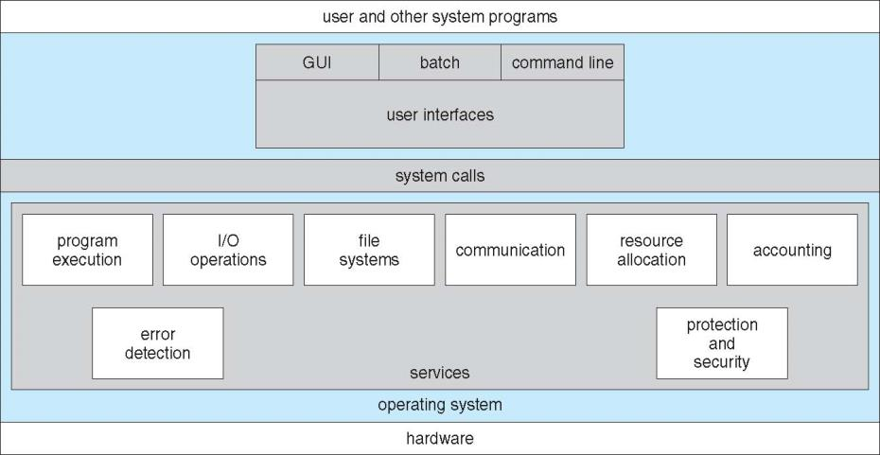
Operating System Services
Notes:
OS provides an environment for execution of programs and services to programs and users
One set of operating-system services provides functions that are helpful to the user:
User interface - Almost all operating systems have a user interface (UI).
Varies between Command-Line (CLI), Graphics User Interface (GUI), Batch
Program execution - The system must be able to load a program into memory and to run that program, end execution, either normally or abnormally (indicating error)
I/O operations - A running program may require I/O, which may involve a file or an I/O device
One set of operating-system services provides functions that are helpful to the user (Cont.):
File-system manipulation - The file system is of particular interest. Programs need to read and write files and directories, create and delete them, search them, list file Information, permission management.
Communications – Processes may exchange information, on the same computer or between computers over a network
Communications may be via shared memory or through message passing (packets moved by the OS)
Error detection – OS needs to be constantly aware of possible errors
May occur in the CPU and memory hardware, in I/O devices, in user program
For each type of error, OS should take the appropriate action to ensure correct and consistent computing
Debugging facilities can greatly enhance the user’s and programmer’s abilities to efficiently use the system
Another set of OS functions exists for ensuring the efficient operation of the system itself via resource sharing
Resource allocation - When multiple users or multiple jobs running concurrently, resources must be allocated to each of them
Many types of resources - CPU cycles, main memory, file storage, I/O devices.
Accounting - To keep track of which users use how much and what kinds of computer resources
Protection and security - The owners of information stored in a multiuser or networked computer system may want to control use of that information, concurrent processes should not interfere with each other
Protection involves ensuring that all access to system resources is controlled
Security of the system from outsiders requires user authentication, extends to defending external I/O devices from invalid access attempts

Slide 13
Kernel Mode vs. User Mode
Kernel Mode.
Executing code has complete and unrestricted access to the underlying hardware.
Is reserved for the lowest-level, trusted functions of OS.
Crashes in this mode are catastrophic.
User Mode
Executing code has no ability to directly access hardware
Code must delegate to system APIs to access hardware
Crashes in user mode are always recoverable
Notes:
Kernel ModeIn Kernel mode, the executing code has complete and unrestricted access to the underlying hardware. It can execute any CPU instruction and reference any memory address. Kernel mode is generally reserved for the lowest-level, most trusted functions of the operating system. Crashes in kernel mode are catastrophic; they will halt the entire PC.
User ModeIn User mode, the executing code has no ability to directly access hardware or reference memory. Code running in user mode must delegate to system APIs to access hardware or memory. Due to the protection afforded by this sort of isolation, crashes in user mode are always recoverable. Most of the code running on your computer will execute in user mode.

Slide 14
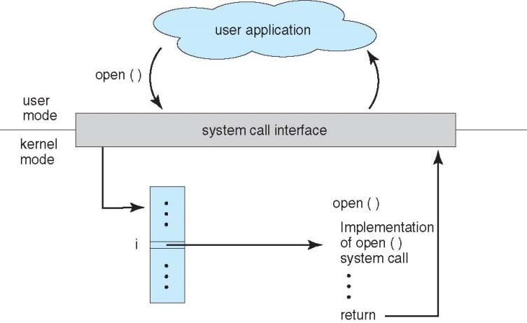
API – System Call – OS Relationship

Slide 15
User Goals vs. System Goals
Which of the following goals are end-user goals?
Which of the following goals are system goals?
Convenient to use
Easy to implement
Easy to learn
Reliable
Easy to maintain
Flexible
Error-free
Efficient and Fast
Safe
Easy to design
Notes:
Design and Implementation of OS not “solvable”, but some approaches have proven successful
Internal structure of different Operating Systems can vary widely
Start the design by defining goals and specifications
Affected by choice of hardware, type of system
Users: use and learn
System: design, implement, and maintain
User goals and System goals
User goals – operating system should be convenient to use, easy to learn, reliable, safe, and fast
System goals – operating system should be easy to design, implement, and maintain, as well as flexible, reliable, error-free, and efficient

Slide 16
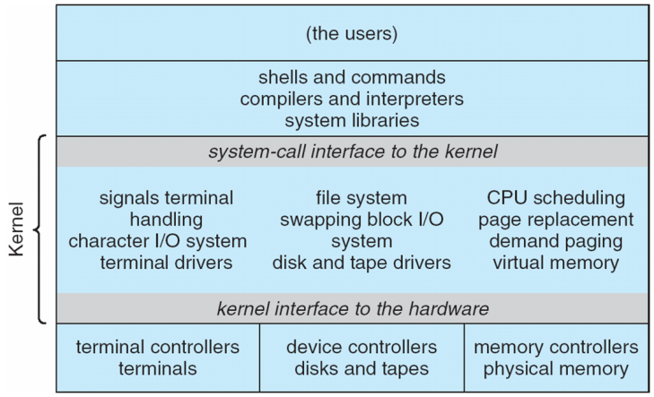
Monolithic Kernel: Pros and Cons? UNIX System Structure
Notes:
A monolithic kernel is an operating system architecture where the entire operating system is working in kernel space and is alone in supervisor mode. The monolithic model differs from other operating system architectures (such as the microkernel architecture)^{[1][2]} in that it alone defines a high-level virtual interface over computer hardware. A set of primitives or system calls implement all operating system services such as process management, concurrency, and memory management. Device drivers can be added to the kernel as modules.
Non Simple Structure -- UNIX
UNIX – limited by hardware functionality, the original UNIX operating system had limited structuring. The UNIX OS consists of two separable parts
Systems programs
The kernel
Consists of everything below the system-call interface and above the physical hardware
Provides the file system, CPU scheduling, memory management, and other operating-system functions; a large number of functions for one level

Slide 17
Microkernel System Structure
What are the pros and cons of this structure?
Notes:
In computer science, a microkernel (also known as μ-kernel) is the near-minimum amount of software that can provide the mechanisms needed to implement an operating system (OS). These mechanisms include low-level address space management,thread management, and inter-process communication (IPC).
Moves as much from the kernel into user space
Mach example of microkernel
Mac OS X kernel (Darwin) partly based on Mach
Communication takes place between user modules using message passing
Benefits:
Easier to extend a microkernel
Easier to port the operating system to new architectures
More reliable (less code is running in kernel mode)
More secure
Detriments:
Performance overhead of user space to kernel space communication

Slide 18
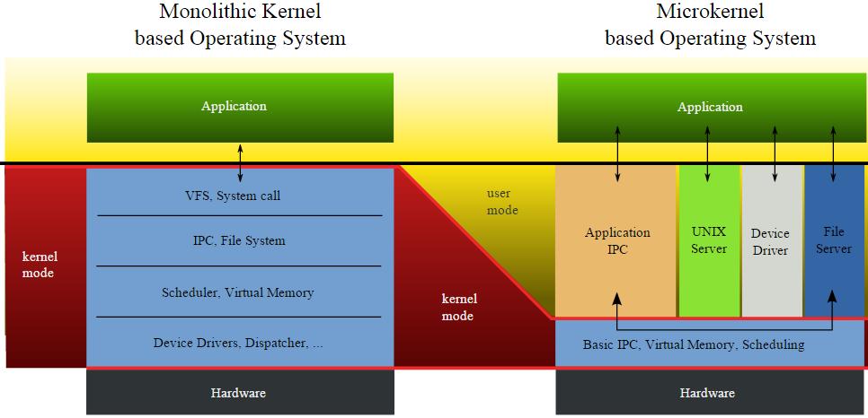
Monolithic Kernel vs. Microkernel
Which structure should we use to build an OS for embedded systems (e.g., real-time robotic systems)?

Slide 19
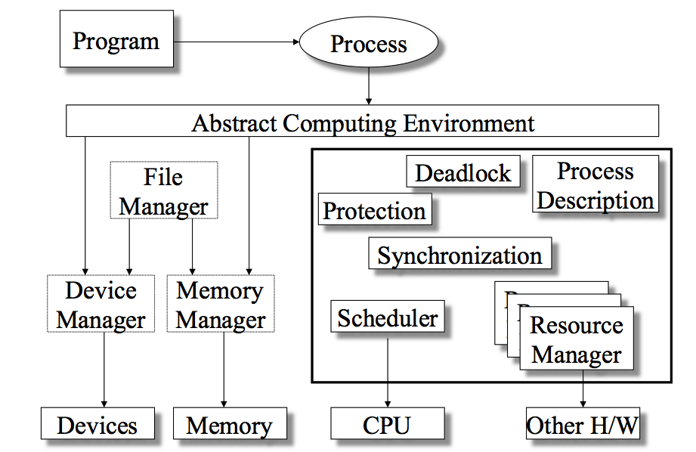
Process Manager Overview
Notes:
Where is the process manager?
The information in the preceding list is stored in a data structure, typically
called a process control block ( Figure 3.1 ), that is created and managed by the OS.
The significant point about the process control block is that it contains sufficient
information so that it is possible to interrupt a running process and later resume
execution as if the interruption had not occurred. The process control block is
the key tool that enables the OS to support multiple processes and to provide for
multiprocessing. When a process is interrupted, the current values of the program
counter and the processor registers (context data) are saved in the appropriate fields
of the corresponding process control block, and the state of the process is changed
to some other value, such as blocked or ready (described subsequently). The OS is
now free to put some other process in the running state. The program counter and
context data for this process are loaded into the processor registers and this process
now begins to execute.
Thus, we can say that a process consists of program code and associated data
plus a process control block. For a single-processor computer, at any given time, at
most one process is executing and that process is in the running state.

Slide 20
What is a process?
An instance of a program in execution.
Notes:
Only four words: a program in execution.
Must use a minimal of five chinese characters to define process.
Now that we have the concepts of applications, system software, and resources,
we are in a position to discuss how the OS can, in an orderly fashion, manage the
execution of applications so that
• Resources are made available to multiple applications.
• The physical processor is switched among multiple applications so all will
appear to be progressing.
• The processor and I/O devices can be used efficiently.
The approach taken by all modern operating systems is to rely on a model in
which the execution of an application corresponds to the existence of one or more
processes.

Slide 21
Process: A Program in Execution
The program code, also called text section
Current activity including program counter, processor registers
Stack containing temporary data
Function parameters, return addresses, local variables
Data section containing global variables
Heap containing memory dynamically allocated during run time
Notes:
An operating system executes a variety of programs:
Batch system – jobs
Time-shared systems – user programs or tasks
Textbook uses the terms job and process almost interchangeably
Process – a program in execution; process execution must progress in sequential fashion
Multiple parts
The program code, also called text section
Current activity including program counter, processor registers
Stack containing temporary data
Function parameters, return addresses, local variables
Data section containing global variables

Slide 22
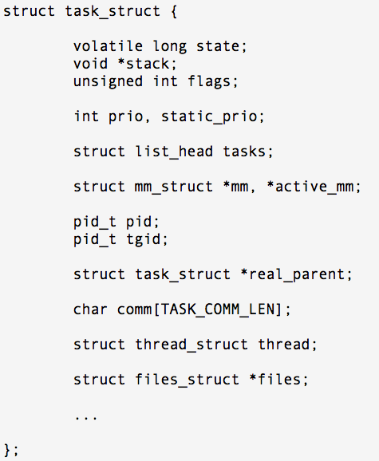
Process Control Block
Contains the process elements
It is possible to interrupt a running process and later resume execution as if the interruption had not occurred
Created and managed by the operating system
Key tool that allows support for multiple processes
Notes:
The information in the preceding list is stored in a data structure, typically
called a process control block ( Figure 3.1 ), that is created and managed by the OS.
The significant point about the process control block is that it contains sufficient
information so that it is possible to interrupt a running process and later resume
execution as if the interruption had not occurred. The process control block is
the key tool that enables the OS to support multiple processes and to provide for
multiprocessing. When a process is interrupted, the current values of the program
counter and the processor registers (context data) are saved in the appropriate fields
of the corresponding process control block, and the state of the process is changed
to some other value, such as blocked or ready (described subsequently). The OS is
now free to put some other process in the running state. The program counter and
context data for this process are loaded into the processor registers and this process
now begins to execute.
Thus, we can say that a process consists of program code and associated data
plus a process control block. For a single-processor computer, at any given time, at
most one process is executing and that process is in the running state.

Slide 23
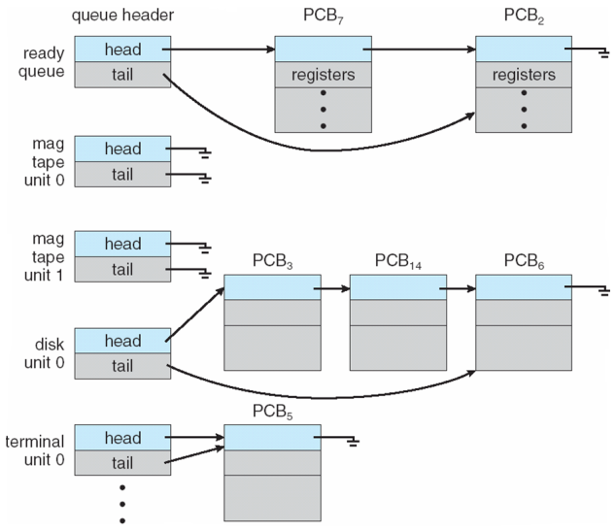
How to use PCB? Ready Queue and Various I/O Device Queues

Slide 24
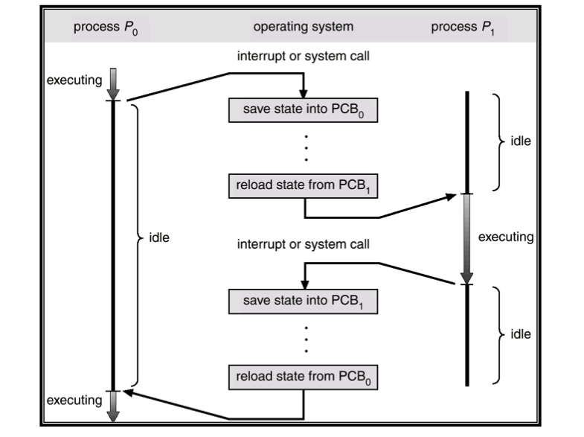
How to use PCB? CPU Switch from Process to Process
Notes:
The information in the preceding list is stored in a data structure, typically
called a process control block ( Figure 3.1 ), that is created and managed by the OS.
The significant point about the process control block is that it contains sufficient
information so that it is possible to interrupt a running process and later resume
execution as if the interruption had not occurred. The process control block is
the key tool that enables the OS to support multiple processes and to provide for
multiprocessing. When a process is interrupted, the current values of the program
counter and the processor registers (context data) are saved in the appropriate fields
of the corresponding process control block, and the state of the process is changed
to some other value, such as blocked or ready (described subsequently). The OS is
now free to put some other process in the running state. The program counter and
context data for this process are loaded into the processor registers and this process
now begins to execute.
Thus, we can say that a process consists of program code and associated data
plus a process control block. For a single-processor computer, at any given time, at
most one process is executing and that process is in the running state.

Slide 25
Context Switch
When CPU switches to another process
OS must save the state of the old process
load the saved state for the new process via a context switch
Context of a process represented in the PCB
The complexity of the OS and the PCB
hardware support: e.g., multiple sets of registers per CPU; multiple contexts loaded at once
What does context-switch overhead dependent?
Notes:
When CPU switches to another process
OS must save the state of the old process
load the saved state for the new process via a context switch
Context of a process represented in the PCB
Context-switch time is overhead; the system does no useful work while switching
The more complex the OS and the PCB ➔ the longer the context switch
Time dependent on hardware support
Some hardware provides multiple sets of registers per CPU ➔ multiple contexts loaded at once

Slide 26
Two-State Process Model
Notes:
The operating system’s principal responsibility is controlling the execution of
processes; this includes determining the interleaving pattern for execution and allocating
resources to processes. The first step in designing an OS to control processes
is to describe the behavior that we would like the processes to exhibit.
We can construct the simplest possible model by observing that, at any time, a
process is either being executed by a processor or not. In this model, a process may
be in one of two states: Running or Not Running, as shown in Figure 3.5a . When
the OS creates a new process, it creates a process control block for the process and
enters that process into the system in the Not Running state. The process exists,
is known to the OS, and is waiting for an opportunity to execute. From time to
time, the currently running process will be interrupted and the dispatcher portion
of the OS will select some other process to run. The former process moves from the
Running state to the Not Running state, and one of the other processes moves to
the Running state.

Slide 27
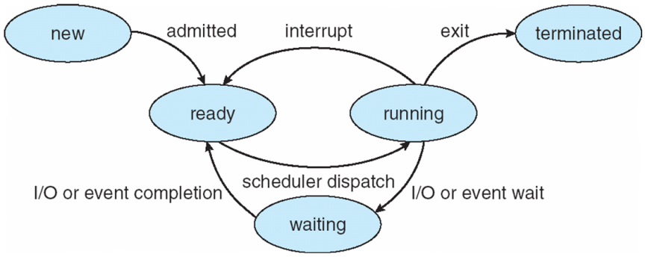
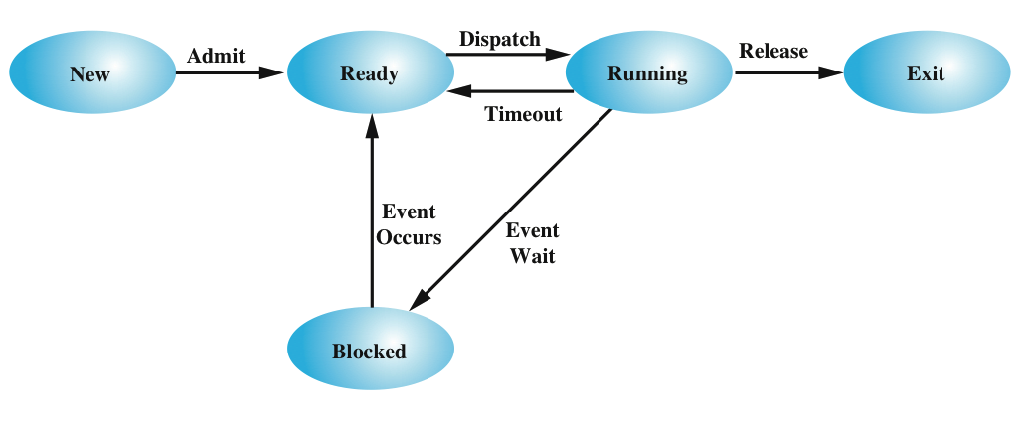
Five-State Process Model
Notes:
Write on whiteboard:
Event-driven:
switch (event) {
case INTERRUPT:
if (state == RUNNING)
…
state = READY;
break;
if …
}
State-driven:
switch (state) {
case RUNNING:
if (event == INTERRUPT)
…
state = READY;
break;
if …
}
If all processes were always ready to execute, then the queuing discipline suggested
by Figure 3.5b would be effective. The queue is a first-in-first-out list and the processor
operates in round-robin fashion on the available processes (each process in
the queue is given a certain amount of time, in turn, to execute and then returned to
the queue, unless blocked). However, even with the simple example that we have
described, this implementation is inadequate: Some processes in the Not Running
state are ready to execute, while others are blocked, waiting for an I/O operation
to complete. Thus, using a single queue, the dispatcher could not just select the
process at the oldest end of the queue. Rather, the dispatcher would have to scan
the list looking for the process that is not blocked and that has been in the queue
the longest.
A more natural way to handle this situation is to split the Not Running state
into two states: Ready and Blocked. This is shown in Figure 3.6 .
The five states in this new diagram are:
• Running: The process that is currently being executed. For this chapter, we
will assume a computer with a single processor, so at most one process at a
time can be in this state.
• Ready: A process that is prepared to execute when given the opportunity.
• Blocked/Waiting: A process that cannot execute until some event occurs,
such as the completion of an I/O operation.
• New: A process that has just been created but has not yet been admitted to the
pool of executable processes by the OS. Typically, a new process has not yet
been loaded into main memory, although its process control block has been
created.
• Exit: A process that has been released from the pool of executable processes
by the OS, either because it halted or because it aborted for some reason.
Figure 3.6 indicates the types of events that lead to each state transition for a
process; the possible transitions are as follows:
• Null : New: A new process is created to execute a program. This event occurs
for any of the reasons listed in Table 3.1 .
• New : Ready: The OS will move a process from the New state to the Ready
state when it is prepared to take on an additional process. Most systems set
some limit based on the number of existing processes or the amount of virtual
memory committed to existing processes. This limit assures that there are not
so many active processes as to degrade performance.
• Ready : Running: When it is time to select a process to run, the OS chooses
one of the processes in the Ready state. This is the job of the scheduler or
dispatcher. Scheduling is explored in Part Four.
• Running : Exit: The currently running process is terminated by the OS if the
process indicates that it has completed, or if it aborts. See Table 3.2 .
• Running : Ready: The most common reason for this transition is that the
running process has reached the maximum allowable time for uninterrupted
execution; virtually all multiprogramming operating systems impose this type
of time discipline. There are several other alternative causes for this transition,
which are not implemented in all operating systems. Of particular importance
is the case in which the OS assigns different levels of priority to different
processes.
Running : Blocked: A process is put in the Blocked state if it requests something
for which it must wait. A request to the OS is usually in the form of a
system service call; that is, a call from the running program to a procedure
that is part of the operating system code. For example, a process may request
a service from the OS that the OS is not prepared to perform immediately. It
can request a resource, such as a file or a shared section of virtual memory,
that is not immediately available. Or the process may initiate an action, such
as an I/O operation, that must be completed before the process can continue.
When processes communicate with each other, a process may be blocked
when it is waiting for another process to provide data or waiting for a message
from another process.
• Blocked : Ready: A process in the Blocked state is moved to the Ready state
when the event for which it has been waiting occurs.
• Ready : Exit: For clarity, this transition is not shown on the state diagram. In
some systems, a parent may terminate a child’ process at any time. Also, if a parent
terminates, all child processes associated with that parent may be terminated.
• Blocked : Exit: The comments under the preceding item apply.

Slide 28
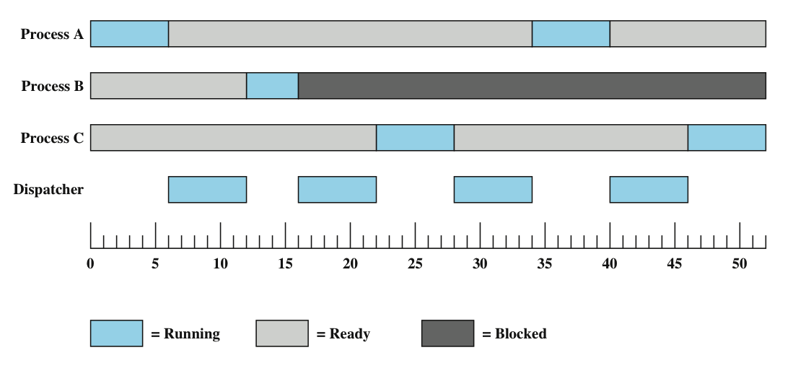
What is the dispatcher?
Notes:
Returning to our simple example, Figure 3.7 shows the transition of each process
among the states.

Slide 29
Suspended Processes: Swapping
Moving part of all of a process from main memory to disk
When none of the processes in main memory is in the Ready state, the OS swaps one of the blocked processes out on to disk into a suspend queue
Notes:
Recall that the reason for all of this elaborate machinery is that I/O activities
are much slower than computation and therefore the processor in a uniprogramming
system is idle most of the time. But the arrangement of Figure 3.8b does not entirely
solve the problem. It is true that, in this case, memory holds multiple processes and
that the processor can move to another process when one process is blocked. But the
processor is so much faster than I/O that it will be common for all of the processes in
memory to be waiting for I/O. Thus, even with multiprogramming, a processor could
be idle most of the time.
What to do? Main memory could be expanded to accommodate more processes.
But there are two flaws in this approach. First, there is a cost associated with
main memory, which, though small on a per-byte basis, begins to add up as we get
into the gigabytes of storage. Second, the appetite of programs for memory has
grown as fast as the cost of memory has dropped. So larger memory results in larger
processes, not more processes.
Another solution is swapping, which involves moving part or all of a process
from main memory to disk. When none of the processes in main memory is in the
Ready state, the OS swaps one of the blocked processes out on to disk into a suspend
queue. This is a queue of existing processes that have been temporarily kicked
out of main memory, or suspended. The OS then brings in another process from the
suspend queue, or it honors a new-process request. Execution then continues with
the newly arrived process.
Swapping, however, is an I/O operation, and therefore there is the potential
for making the problem worse, not better. But because disk I/O is generally the
fastest I/O on a system (e.g., compared to tape or printer I/O), swapping will usually
enhance performance.

Slide 30
A Process model with the Suspend State
Notes:
Draw the five state on the whiteboard.
With the use of swapping as just described, one other state must be added to
our process behavior model ( Figure 3.9a ): the Suspend state. When all of the processes
in main memory are in the Blocked state, the OS can suspend one process by
putting it in the Suspend state and transferring it to disk. The space that is freed in
main memory can then be used to bring in another process.
When the OS has performed a swapping-out operation, it has two choices for
selecting a process to bring into main memory: It can admit a newly created process
or it can bring in a previously suspended process. It would appear that the preference
should be to bring in a previously suspended process, to provide it with service
rather than increasing the total load on the system.
But this line of reasoning presents a difficulty. All of the processes that have
been suspended were in the Blocked state at the time of suspension. It clearly would
not do any good to bring a blocked process back into main memory, because it is
still not ready for execution. Recognize, however, that each process in the Suspend
state was originally blocked on a particular event. When that event occurs, the process
is not blocked and is potentially available for execution.

Slide 31
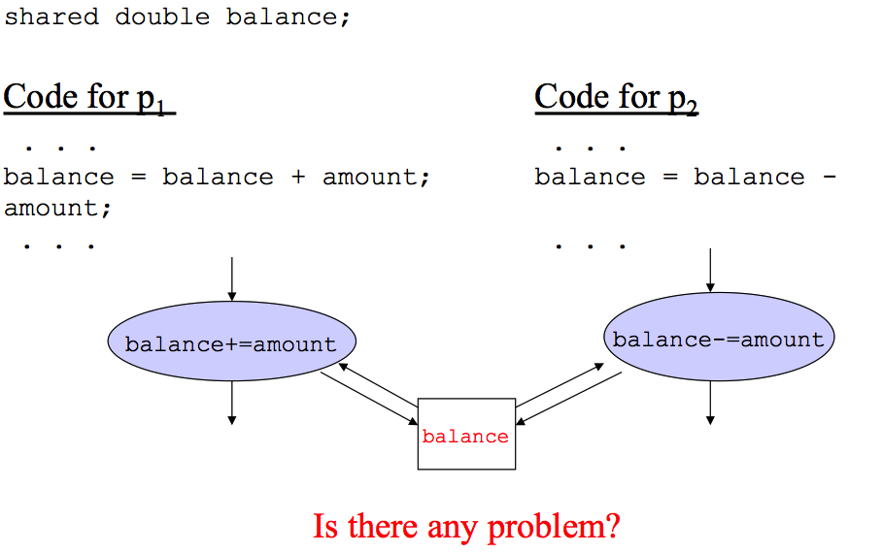
Example: Critical Sections
Notes:
At first glance, it may seem that interleaving and overlapping represent fundamentally different modes of execution and present different problems. In fact, both techniques can be viewed as examples of concurrent processing, and both present the same problems. In the case of a uniprocessor, the problems stem from a basic characteristic of multiprogramming systems: The relative speed of execution of processes cannot be predicted. It depends on the activities of other processes, the way in which the OS handles interrupts, and the scheduling policies of the OS.

Slide 32
Race Condition
Occurs when multiple processes or threads read and write data items
The final result depends on the order of execution
the “loser” of the race is the process that updates last and will determine the final value of the variable
Notes:
A race condition occurs when multiple processes or threads read and write data items so that the final result depends on the order of execution of instructions in the multiple processes. Let us consider two simple examples.
As a first example, suppose that two processes, P1 and P2, share the global variable a . At some point in its execution, P1 updates a to the value 1, and at some point in its execution, P2 updates a to the value 2. Thus, the two tasks are in a race to write variable a . In this example, the “loser” of the race (the process that updates last) determines the final value of a .
For our second example, consider two process, P3 and P4, that share global variables b and c , with initial values b = 1 and c = 2 . At some point in its execution, P3 executes the assignment b = b + c , and at some point in its execution, P4 executes the assignment c = b + c . Note that the two processes update different variables. However, the final values of the two variables depend on the order in which the two processes execute these two assignments. If P3 executes its assignment statement first, then the final values are b = 3 and c = 5 . If P4 executes its assignment statement first, then the final values are b = 4 and c = 3 .
Appendix A includes a discussion of race conditions using semaphores as an example.

Slide 33
Requirements for Mutual Exclusion
Must be enforced
A process that halts must do so without interfering with other processes
No deadlock or starvation
A process must not be denied access to a critical section when there is no other process using it
No assumptions are made about relative process speeds or number of processes
A process remains inside its critical section for a finite time only
Notes:
Any facility or capability that is to provide support for mutual exclusion should
meet the following requirements:
1. Mutual exclusion must be enforced: Only one process at a time is allowed into
its critical section, among all processes that have critical sections for the same resource or shared object.
2. A process that halts in its noncritical section must do so without interfering
with other processes.
3. It must not be possible for a process requiring access to a critical section to be
delayed indefinitely: no deadlock or starvation.
4. When no process is in a critical section, any process that requests entry to its
critical section must be permitted to enter without delay.
5. No assumptions are made about relative process speeds or number of processors.
6. A process remains inside its critical section for a finite time only.
There are a number of ways in which the requirements for mutual exclusion can be satisfied. One approach is to leave the responsibility with the processes that wish to execute concurrently. Processes, whether they are system programs or application programs, would be required to coordinate with one another to enforce mutual exclusion, with no support from the programming language or the OS. We can refer to these as software approaches. Although this approach is prone to high processing overhead and bugs, it is nevertheless useful to examine such approaches to gain a better understanding of the complexity of concurrent processing. This topic is covered in Appendix A . A second approach involves the use of special purpose machine instructions. These have the advantage of reducing overhead but nevertheless will be shown to be unattractive as a general-purpose solution; they are covered in Section 5.2 . A third approach is to provide some level of support within the OS or a programming language. Three of the most important such approaches are examined in Sections 5.3 through 5.5 .

Slide 34
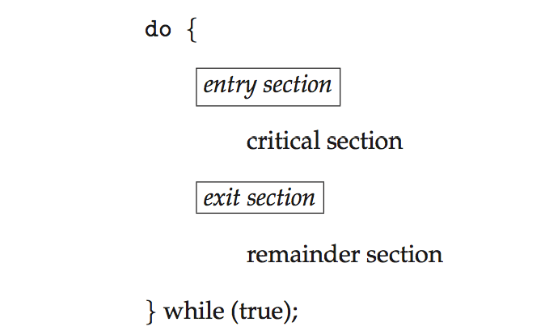
General structure of process P_{i}

Slide 35
Solution to Critical-Section Problem
1. Mutual Exclusion If process P_{i} is executing in its critical section, then
2. Progress If no process is executing in its critical section and there exist some processes that wish to enter their critical section, then
3. Bounded Waiting A bound must exist on the number of times that other processes are allowed to enter their critical sections after a process has made a request to enter its critical section and before that request is grant
Notes:
Mutual Exclusion - If process P_{i} is executing in its critical section, then no other processes can be executing in their critical sections
2. Progress - If no process is executing in its critical section and there exist some processes that wish to enter their critical section, then the selection of the processes that will enter the critical section next cannot be postponed indefinitely
3. Bounded Waiting - A bound must exist on the number of times that other processes are allowed to enter their critical sections after a process has made a request to enter its critical section and before that request is granted
Assume that each process executes at a nonzero speed
No assumption concerning relative speed of the n processes

Slide 36
The Peterson’s Algorithm
do {
flag[i] = true;
turn = j;
while (flag[j] && turn = = j);
critical section
flag[i] = false;
remainder section
} while (true);
Notes:
Question: How to control turns?
Assumption: the load and store instructions are atomic
The two processes share two variables:
int turn;
Boolean flag[2]
turn: whose turn it is to enter the critical section
flag: to indicate if a process is ready to enter the critical section. flag[i] = true implies that process P_{i} is ready!

Slide 37
Solution to Critical-section Problem Using Locks
do {
acquire lock
critical section
release lock
remainder section
} while (TRUE);

Slide 38
test_and_set Instruction
boolean test_and_set (boolean *target)
{
boolean rv = *target;
*target = TRUE;
return rv;
}
Executed atomically
Returns the original value of passed parameter
Set the new value of passed parameter to “TRUE”.

Slide 39
Solution using test_and_set()
Shared Boolean variable lock, initialized to FALSE
Solution:
do { /* do nothing */
while (test_and_set(&lock));
/* critical section */
lock = false;
/* remainder section */
} while (true);

Slide 40
The compare_and_swap Instruction
int compare_and_swap(int *value, int expected, int new_value) {
int temp = *value;
if (*value == expected)
*value = new_value;
return temp;
}
Executed atomically
Returns the original value of passed parameter “value”
Set the variable “value” the value of the passed parameter “new_value” but only if “value” ==“expected”. That is, the swap takes place only under this condition.
Notes:
Similar to test_and_set

Slide 41
How to use compare_and_swap?
Shared integer “lock” initialized to 0;
do { while (compare_and_swap(&lock, 0, 1) != 0 )
; /* do nothing */
/* critical section */
lock = 0;
/* remainder section */
} while (true);
It is locked!
Who locks this section?
Unlocked it!
Notes:
Answer: Bounded-waiting Problem

Slide 42
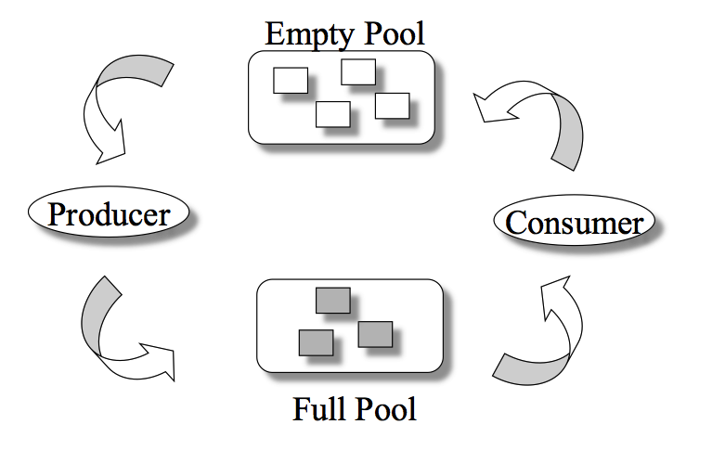
The Bounded-Buffer Problem
n buffers, each can hold one item
Semaphore mutex: initial value 1
Semaphore full: initial value 0
Semaphore empty initial value n
Notes:
Classical Problems of Synchronization
Classical problems used to test newly-proposed synchronization schemes
Bounded-Buffer Problem
Readers and Writers Problem
Dining-Philosophers Problem
Semaphore mutex initialized to the value 1
Semaphore full initialized to the value 0
Semaphore empty initialized to the value n

Slide 43

The Readers-Writers Problem
Concurrent processes
Readers – only read data; do not perform updates
Writers – both read and write
Problem:
Allow multiple readers to read at the same time
Only one single writer can access the shared data
What semaphores do we need?
Semaphore rw_mutex initialized to 1
Semaphore mutex initialized to 1
Integer read_count initialized to 0
Notes:
A data set is shared among a number of concurrent processes
Readers – only read the data set; they do not perform any updates
Writers – can both read and write
Problem – allow multiple readers to read at the same time
Only one single writer can access the shared data at the same time
Several variations of how readers and writers are considered – all involve some form of priorities
Shared Data
Data set
Semaphore rw_mutex initialized to 1
Semaphore mutex initialized to 1
Integer read_count initialized to 0

Slide 44
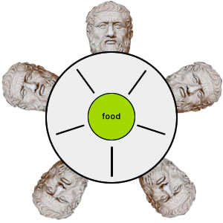
The Dining-Philosophers Problem
Philosophers spend their lives thinking and eating
Occasionally try to pick up 2 chopsticks (one at a time) to eat from bowl
In the case of 5 philosophers: Shared data
Bowl of rice
Semaphore chopstick [5] initialized to 1
Notes:
Philosophers spend their lives alternating thinking and eating
Don’t interact with their neighbors, occasionally try to pick up 2 chopsticks (one at a time) to eat from bowl
Need both to eat, then release both when done
In the case of 5 philosophers
Shared data
Bowl of rice (data set)
Semaphore chopstick [5] initialized to 1

Slide 45
Monitors
A high-level abstraction for process synchronization
Abstract data type: internal variables only accessible by code within the procedure
Only one process may be active within the monitor at a time
But not powerful enough to model some synchronization schemes
monitor monitor-name
{
// shared variable declarations
procedure P1 (…) { …. }
procedure Pn (…) {……}
Initialization code (…) { … }
}
Notes:
A high-level abstraction that provides a convenient and effective mechanism for process synchronization
Abstract data type, internal variables only accessible by code within the procedure
Only one process may be active within the monitor at a time
But not powerful enough to model some synchronization schemes

Slide 46
Project 2 – An Introduction to OS/161 Details Task 3-Reading Code Project 3 – Synchronization Task 1: Code-Reading Assignment
Notes:
Due: Friday, Sept. 5th at 11:55 pm. 1. Project 2 Specification.docxPreview the documentView in a new window 2. How to build tool chain: The MIPS toolchain for os161.txtPreview the documentView in a new window 3. How to build and run sys161.htmlView in a new window 4. gdb.htmView in a new window and cvs.htmView in a new window 5. Configuration file: sys161.confView in a new window Below, you can find five source code packages: 6. os161-1.10.tar.gzView in a new window 7. cs161-binutils-1.4.tarView in a new window 8. Download cs161-gcc-1.4.tar from: https://dl.dropboxusercontent.com/u/24238235/cs161-gcc-1.4.tar 9. Download cs161-gdb-1.4.tar from: https://dl.dropboxusercontent.com/u/24238235/cs161-gdb-1.4.tar 10. sys161-1.12.tar.gzView in a new window

Slide 47
Locks in OS/161
/* kern/include/synch.h */
struct lock {
char *name;
/* add what you need here. How? */
};
struct lock *lock_create(const char *name);
void lock_acquire(struct lock *);
void lock_release(struct lock *);
int lock_do_i_hold(struct lock *);
void lock_destroy(struct lock *);
struct thread *volatile holder;
Notes:
struct lock {
char *name;
// add what you need here
// (don't forget to mark things volatile as needed)
};

Slide 48
Implementing lock_acquire()
void lock_acquire(struct lock *lock) {
turn off interrupts; /*see P(*sem) in next slide*/
if (lock_do_i_hold(lock)) /* check deadlock */
panic("lock %s at %p: Deadlock.\n",
lock->name, lock);
/* wait the lock to become free */
while (lock’s holder != NULL) {
sleep this thread; /*see P(*sem) in next slide*/
}
/* this thread is holding the lock */
lock’s holder is set to curthread;
turn on interrupts to the previous level;
}

Slide 49
How to sleep the current thread?
void P(struct semaphore *sem) {
int spl;
assert(sem != NULL);
spl = splhigh();
while (sem->count==0) {
thread_sleep(sem);
}
assert(sem->count>0);
sem->count--;
splx(spl);
}

Slide 50
How to wakeup a thread?
void V(struct semaphore *sem)
{
int spl;
assert(sem != NULL);
spl = splhigh();
sem->count++;
assert(sem->count>0);
thread_wakeup(sem);
splx(spl);
}

Slide 51
How to implement lock_do_i_hold?
int lock_do_i_hold(struct lock *lock) {
int spl, same;
use assert() to input argument lock;
Turn off interrupts;
if (lock->holder is the same as this thread)
set same to 1; /* true */
else set same to 0; /* false */
Turn on interrupts to previous level;
/* 1 means lock is held by this thread */
return same;
}
Notes:
lock != NULL
This thread = curthread

